Slide 1

MAJOR PROJECT SYNOPSIS
Intelligent Document Summarizer
TEAM MEMBERS: -
ANUSHANT BHUSHAN (1SI17TE004)
SUMANT KUMAR (1SI17TE035)
PAVAN T L (1SI17TE020)
PRAMODH H R (1SI17TE021)
Guide:-
Ms. Susmita Eswar
Assistant Professor
Dept of ETE

Slide 2
OUTLINE:-
Motivation and Introduction
Objective
Overview
Working
a) Data Pre-Processing
b) Model
c) Training
d) Testing
Simulation
Technical Stack
Work to be done
Project Limitation

Slide 3
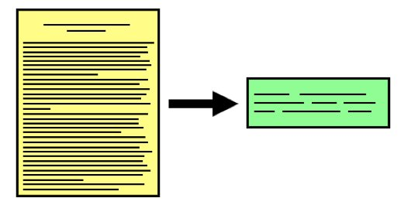
Motivation and Introduction:
Summarization can be defined as a task of producing a concise and fluent summary while preserving key information and overall meaning.
Creating summary of the whole report or document manually is a lengthy and time consuming process.
We are building an application that will summarize the document automatically and produce the summary in both text and audio format.

Slide 4
Objective :
To develop a Summarization Algorithm using deep learning(CNN Algorithm) that aims to generate a summary by ranking sentences, whose performance relies heavily on the quality of sentence features and also to produces summary in audio format.

Slide 5
Overview:
The Project aims to automatically generate summaries of documents through the extraction of sentences in the text and then applying the required algorithm.
We are implementing an Machine learning algorithm where a Convolutional Neural Network approach is proposed.
At first the CNN Model is trained with large predefined DUC dataset by the process of calculating salience score for each sentence in the dataset.
Google’s pretrained word2vec4 Algorithm and also obtain its salience score
Sentences in each document can be ranked according to their salience scores
Summary is generated based on the above ranking system.

Slide 6
Working:-
Python is used due to its versatility and fast production capabilities, as well as the great support it has from deep learning frameworks.
After the proposal phase the coding is divided into four parts
a) Data Pre-processing
b) Model
c) Training
d) Testing

Slide 7
Dataset:-
We have used Document Understanding Conference (DUC) Dataset .
DUC2001 dataset for training and the DUC2002 dataset for testing.
Phase | Documents | Document number | Sentences number
Training | DUC2001 | 358 | 12,831
Testing | DUC2002 | 533 | 15,223

Slide 8
Data Pre-processing:-
In Pre-processing stage we split the documents into sentences using Tokenizer module and obtained their word embedding using Google’s pre-trained word2vec4 module, which was trained on 100 billion words from the Google News dataset.
The salience score for each sentence will be computed.
The salience scores for each sentence, as well as its word embedding, are stored in pickle file formats for multiple reasons as:-
1) It allows fast loading during training,
2) It also enables us to easily change our pre-processing stages without
affecting the training stage.

Slide 9
Salience Score:
To obtain a salience score for each sentence we adopt the widely-accepted automatic summarization evaluation metric ROUGE(pyrouge library) to measure the salience.
We calculate each sentence’s score as follows:-
s = αR1 + (1 − α)R2
We set the coefficient α = 0.5 for balance between the two scores.
The terms R1(refers to unigram) and R2(refers to bigram) are obtained by comparing each sentence in documents with corresponding reference summary.

Slide 10
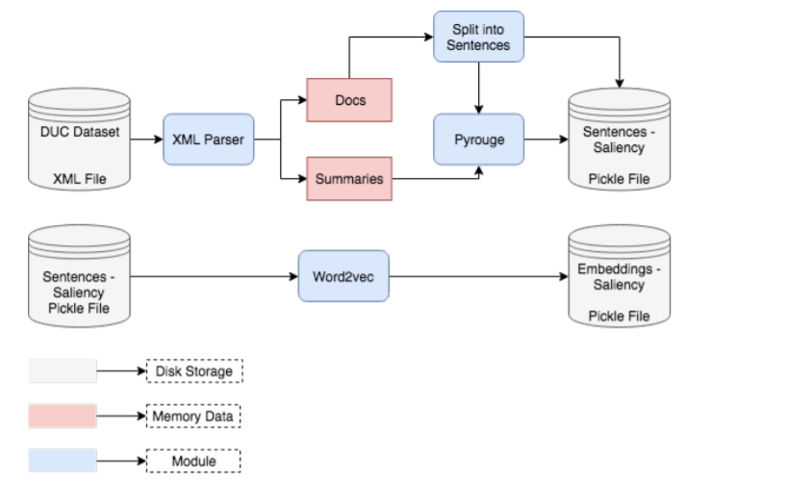
Full pipeline used to produce the training set :

Slide 11
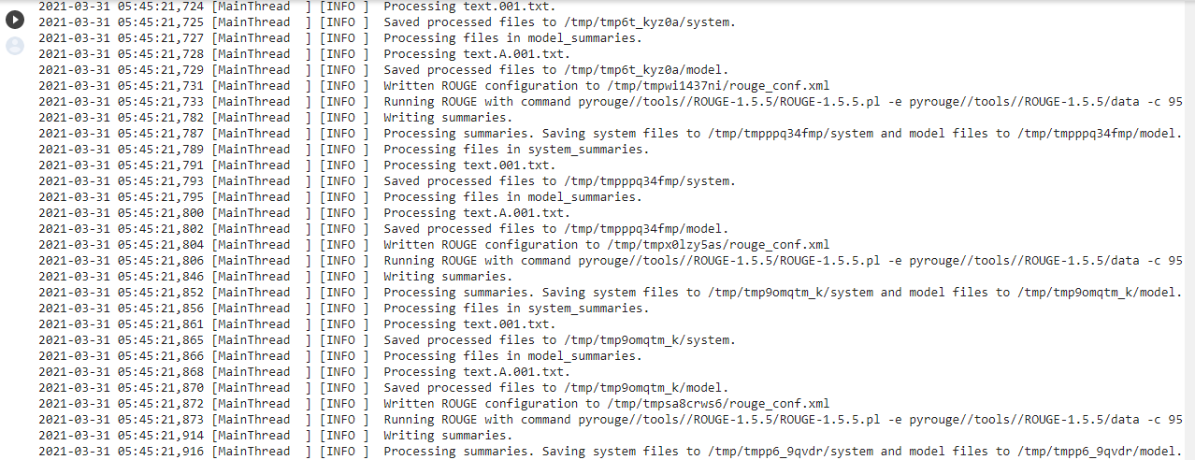
Pre-Processing Simulation:

Slide 12
Model:-
The model we implemented is composed of one convolutional layer, one max pooling layer, one dropout layer and one fully connected layer.
Input: We represent the input as a tensor Each sentence was zero-padded to length n. Each sentence is converted into word embedding vector and a matrix is formed.
Convolutional layer: In order to encode memory in our network the filters need to convolve over multiple words in the sentence and try to extract the score by looking at sequence of n-words. Our convolutional layer has 400 filters.
ReLU layer: It is the first activation function that we use to increase the non-linearity.
Max pooling layer: Then through a max pooling layer we keep the important feature
Dropout layer: The fully connected layer is prone to overfitting so we regularize the model using a dropout layer.
Fully connected layer: We eventually apply a Fully Connected neuron layer
Activation Function: The activation function is the Sigmoid non-linearity.

Slide 13
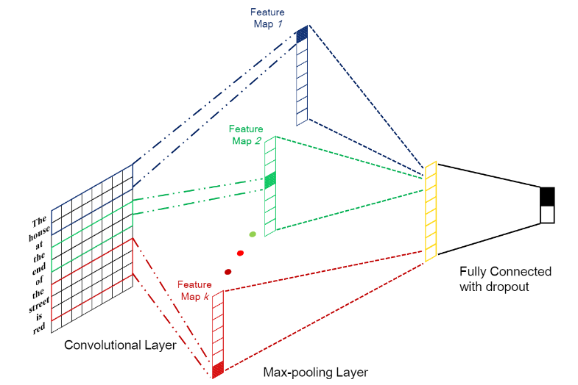
CNN-MODEL

Slide 14
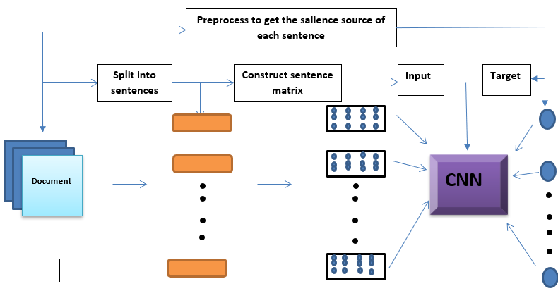
Block-Diagram:
Input

Slide 15
Training:
For training, we load embeddings for words from pickle files and load the salience scores for all sentences.
Regularization: During training, we impose a L2-norm constraint to the weights of the output Fully Connected layer to reduce overfitting of training dataset and improve generalization of the model.
Optimizer: We trained our network with Adadelta update rule with learning rate of 1.0 . We trained all of our networks for 10 epochs using a batch size of 256.

Slide 16
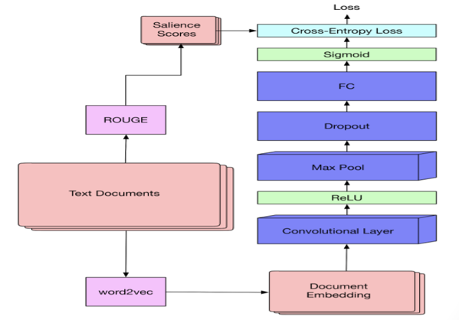
Full training procedure:

Slide 17
Hyperparameters:
Hyperparameter | Value
Number of filters | 400
Filter Window size (n, m) | (300x3)
Dropout probability p | 0.5
ROUGE weight α | 0.5
First activation σ1 | ReLU
Second activation σ2 | Sigmoid
Adadelta learning rate | 1.0
Batch-Size | 256
Epochs | 10

Slide 18
Testing:
First the document is embedded into web application as a .txt
Then the embeddings are fed forward to the network so as to compute the sentences salience scores. We rank the sentences according to their salience scores.
As we want to build a summary with nonredundant sentences, we select sentences so that we only include sentences in the summary which are not too similar with what is already included in the summary.
First we add the sentence with the highest score to the empty summary, then we repeat until the length limit of the final summary is met.
Select the sentence with the next highest score, if the similarity of the sentence with the summary being built is less than a threshold t, then add the sentence to the summary.

Slide 19
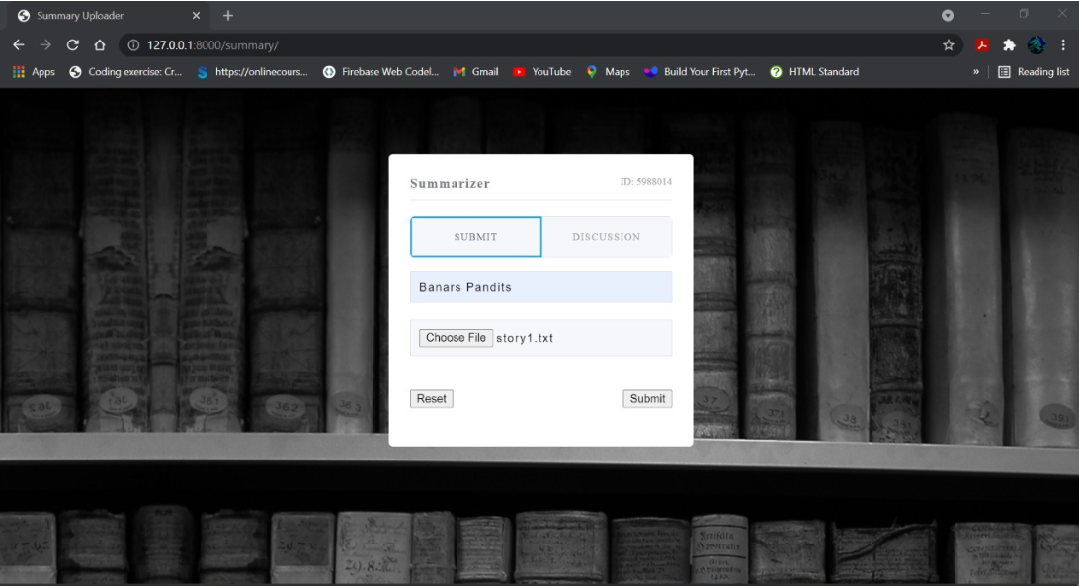
Simulation:
Django Interface for uploading the files
(Web Application)

Slide 20
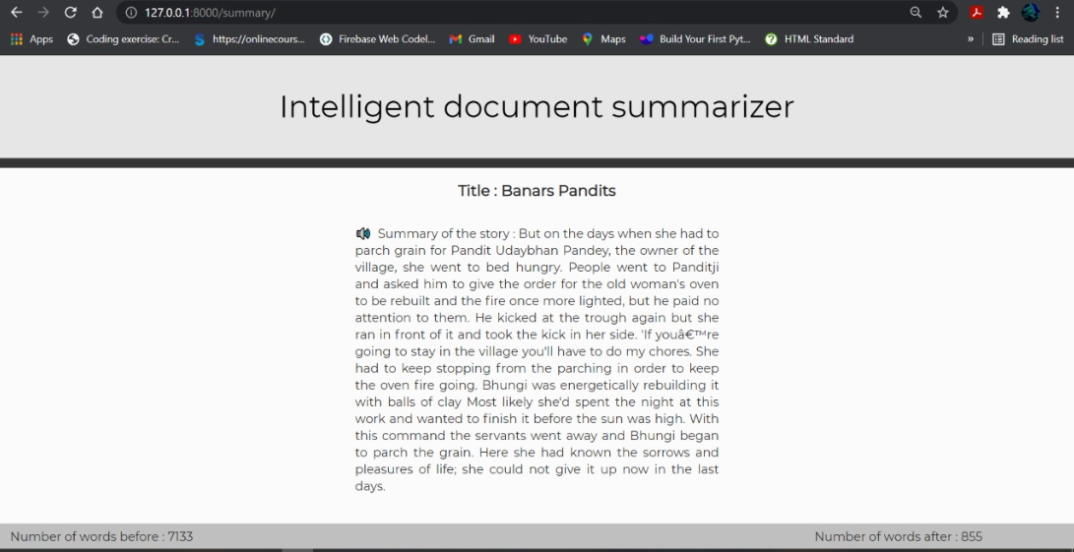
Voice Reader Interface

Slide 21
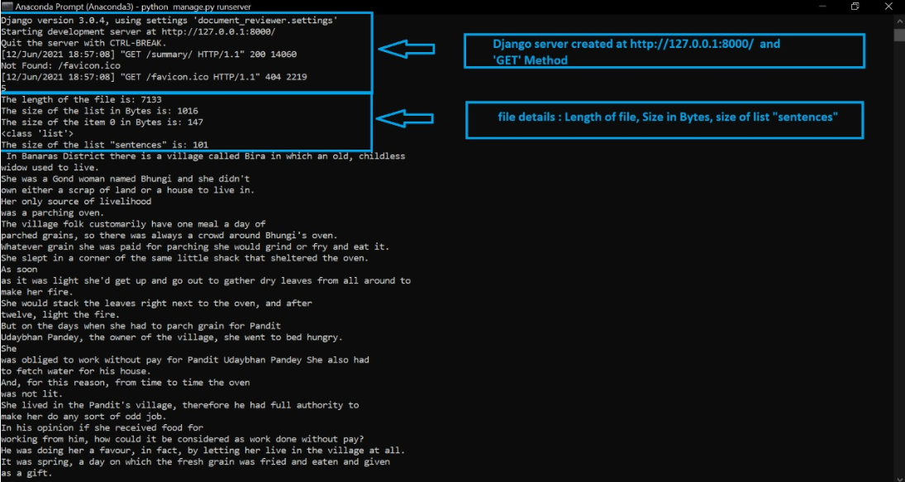
Backend of Django Server

Slide 22
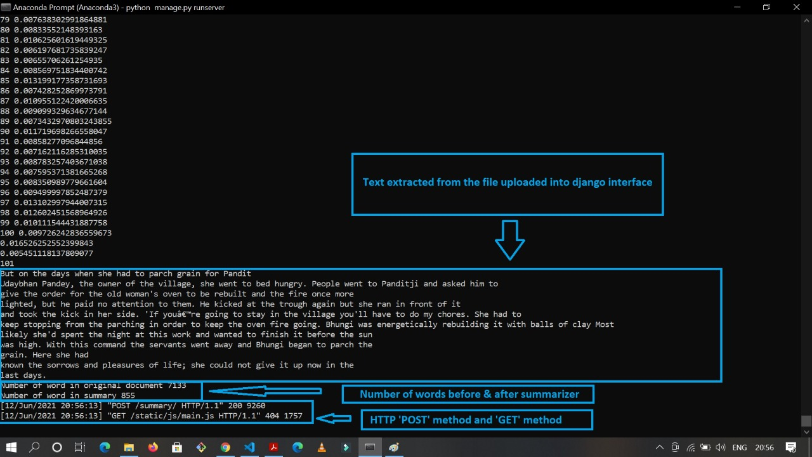
Backend of Django Server

Slide 23
Technical Stack:
Python
It is used as the main programming language for the project.
Word2Vec Algorithm
Word2Vec Algorithm is Google’s pre-trained Algorithm which was trained on 100 billion words from the Google News dataset leading to an embedding of 3 million words.
Django
Django is a high-level Python Web framework that is used for development of the web application
Spyder, Anaconda
Software used for running various algorithm used in this project.
Machine learning (CNN-Algorithm)
Deep learning Algorithm used for training the model and obtaining the final result as a summary.

Slide 24
Work to be done :
We will also implement two types of summary one is short summary and another one is large summary.
We need to implement input as both .txt file and .pdf file.
We also need to make the interface more user friendly.

Slide 25
Limitations(Till Now):
Pre-processing of the dataset is challenging process.
Setting communication between the Django interface and the ML trained model.

Slide 26
THANK YOU!

